Slide 1

LangTriage
Classification of Patient Free-Text Symptom Descriptions by Urgency
Interim Presentation
Team members:
Nofar Kedmi
Diana Akoshvili

Slide 2
Project Description
CHALLENGE:
Hospitals, especially emergency rooms, are overwhelmed with patients presenting a wide variety of medical complaints, often using informal language and inconsistent terminology.
Triage decisions must be made quickly to prioritize care and ensure that urgent cases are treated first — but this manual process is time-consuming and can lead to delays.
OUR SOLUTION:
Developing an NLP model based on a Large Language Model (LLM) to classify patient symptom descriptions into:
0 — Not urgent: Can wait or be monitored
1 — Urgent: Requires immediate medical attention
GOAL:
Support faster and more consistent triage decisions.

Slide 3
From Text to Triage Desicion
Task:
Input: Free text generated from structured clinical measurements.
Output: A numerical label indicating urgency level (0 or 1).
NLP Tasks: Text classification – Assign urgency labels to medical texts, Data to Text Generation – from structured clinical data to symptom descriptions.
Data and evaluation:
Dataset: Kaggle’s Patient Priority Classification dataset
Labels - Provided in the dataset as one of four categories:
Red: Requires immediate life-saving intervention
Orange: Serious symptoms, needs prompt medical attention
Yellow: Moderate symptoms, can wait briefly
Green: Mild condition, safe to wait
Evaluation: Confusion Matrix and metrics: Accuracy, Precision, Recall, F1-Score, AUROC

Slide 4
Prior Art
Source/Title | Machine learning–based triage to identify low-severity patients with a short discharge length of stay in emergency department, 2022 | Development of an Anticipatory Triage-Ranking Algorithm Using Dynamic Simulation of Patients With Trauma | Improving ED Emergency Severity Index Acuity Assignment Using Machine Learning and Clinical Natural Language Processing, 2021
Approach/Model | CatBoost, Logistic Regression, Random Forest | LIFE Priority algorithm | KATE triage model
Data | Triage records collected from two hospitals in Taiwan | An artificial database that included 82,277 patients with trauma injuries. | Electronic medical records from two US hospitals
Metrics | AUC, Precision | Comparison with START algorithm | Accuracy
Results | AUC = 0.755, Precision = 88.7% | LIFE improves the identification of clinical urgency compared to existing algorithms. | 75.7% Accuracy

Slide 5
Pipeline
Mapping to Binary Labels:
Input: Raw urgency levels
('red', 'orange', 'yellow', 'green')
Process: Urgency levels were mapped to binary labels for classification:
red & orange→ 1 (urgent)
yellow & green→ 0 (not urgent)
Output: Binary label column for model training.
Generating a synthetic free-text complaint:
Input: Structured clinical indicators
(e.g. age, gender, blood pressure, glucose, chest pain type)
Process: Transformed into textual descriptions using GPT-4 model.
Output: Synthetic complaints stored in a new column called text_input, used as input to the language models.
.
Tokenization & vectorization:
Input: patient complaint.
Process:
For TF-IDF model: based on term frequency and inverse document frequency.
For DistilBERT model: Built-in tokenization (WordPiece) + contextual embedding vectors.
Output: Vectorized representation of each text sample for model input.

Slide 6

Structured Features & Patient Descriptions Overview
Main Features:
Age
Gender
BMI
Insulin
Blood pressure
Chest pain type
Plasma glucose
Exercise angina
Heart disease
Cholesterol
Residence type
Smoking status
Case Examples
“I'm a 37-year-old man.
I feel blurred vision and cannot concentrate.
I also feel very thirsty and go to the bathroom more frequently than usual"
"I am a 48-year-old woman. I have been feeling dizzy and tired for the past two days. There is a slight, unclear feeling in my chest."

Slide 7
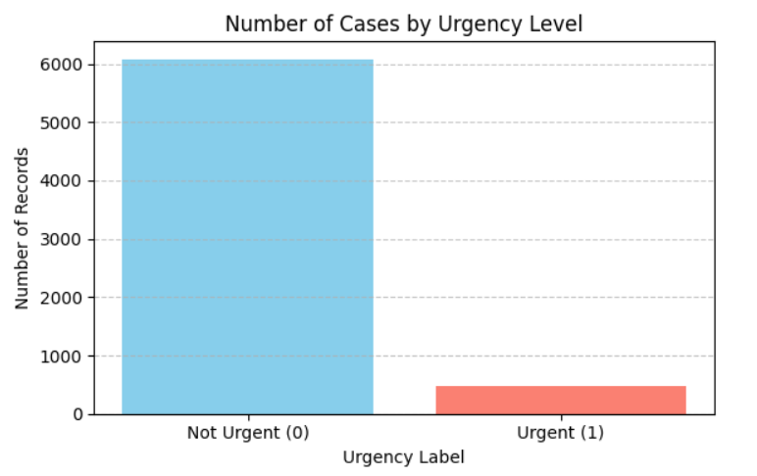
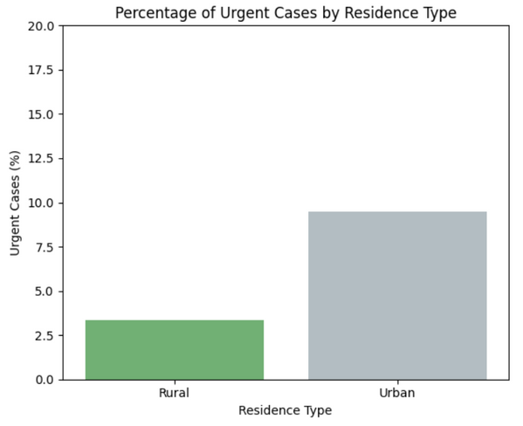
EDA
Dataset size: 6962 patient records with 17 structured clinical and features.
Duplicate row check: None in dataset.
Missing values: Handled or removed to ensure clean input.
Class distribution:
Urgent (1): 8% , Not urgent (0): 92%
Correlation: presented using a correlation matrix. There are no significant relationships between variables and the target variable.

Slide 8
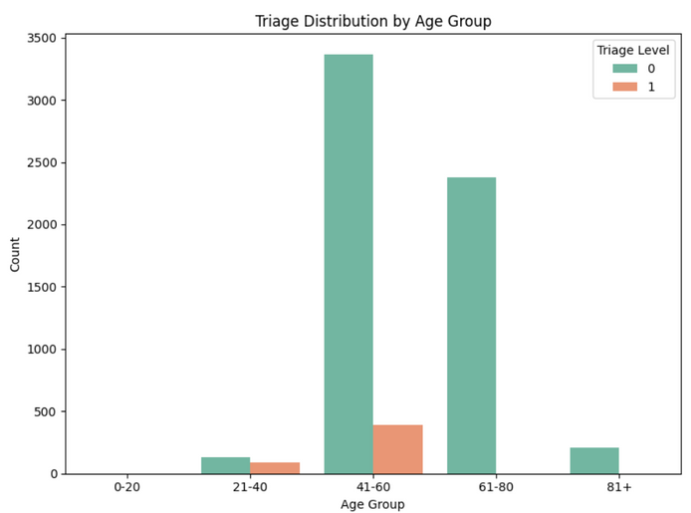
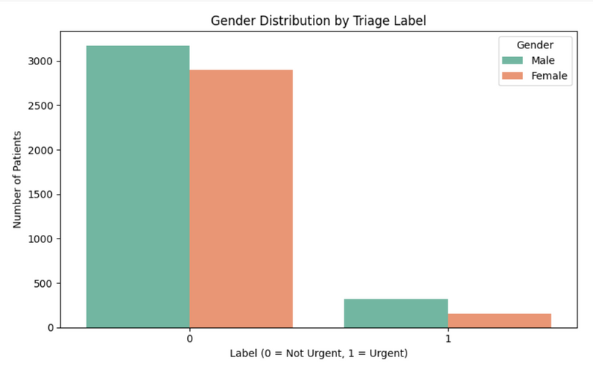
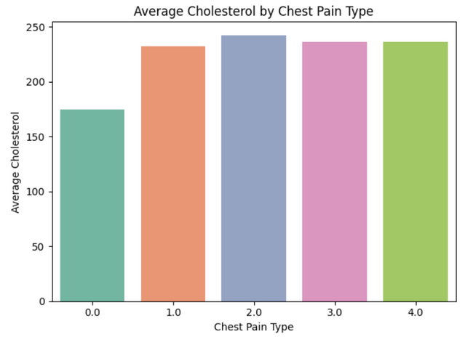
EDA - Insights
Middle age (41-60) is likely to be the age with the highest risk for problems requiring immediate treatment.
Among emergency patients (label = 1): Men constitute a larger group of emergency cases than women.
There is a strong association between patients reporting non-classical chest pain (atypical angina) and high cholesterol levels - possibly due to a link to cardiovascular disease.
A potential relationship was observed between place of residence and urgency level: the proportion of urgent cases was higher among patients living in urban areas compared to those in rural areas.

Slide 9
Models & Evalution
Models: Compare models:
Baseline Model – TF-IDF + Logistic Regression:
A relatively simple model in which texts are converted to numeric vectors using TF-IDF
(which measures the importance of words in a document) and then classified with logistic regression.
Advanced Model – Fine-tuned DistilBERT:
Enhanced Transformer language model (DistilBERT) fine-tuned on our data. This is a model that understands language context at a high level.
Data splitting:
Dividing into 80% training and 20% testing.
Evalution:
Confusion Matrix and metrics: Accuracy, Precision, Recall, F1-Score, AUROC

Slide 10
Baseline - Overview
Text vectorization:
Converting patient complaints into numeric vectors, by calculating the frequency of words relative to other documents (TF-IDF). Both single words (unigrams) and word pairs (bigrams) are included.
Feature restriction:
The top 1,000 most informative words and word pairs are selected to reduce dimensionality
(max_features=1000).
Model Training and Prediction:
A logistic regression classifier is trained on the vectors to predict the urgency level of each case
(0 = Not Urgent, 1 = Urgent).

Slide 11
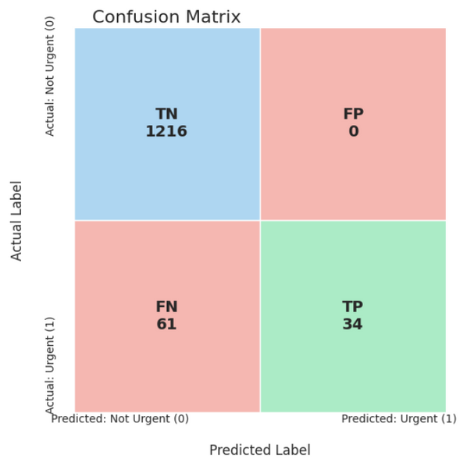
Baseline - Results
Accuracy (0.95): The model classifies most samples correctly.
Recall (0.36): Only 36% of urgent cases were detected — out of 95 urgent cases, 61 were missed.
Precision (1.00): When a case is predicted as urgent, it is almost always correct — preventing false alarms.
F1-Score (0.53): Overall performance is moderate due to low recall.
AUROC (0.91): Good discrimination between urgent and non-urgent cases.

Slide 12
Conclusions and Next Steps
The basic model successfully identifies non-urgent cases but misses many urgent ones, which can be dangerous
in clinical settings. This issue is likely caused by an imbalance between urgent and non-urgent cases.
Future Recommendations:
1. Resampling the Categories – Apply techniques to address class imbalance:
SMOTE: Generate synthetic examples of urgent cases.
Undersampling: Reduce the number of non-urgent examples.
Combination of both: Achieve a better balance between the classes.
2. Model-Level Adjustments – Improve recall without altering the dataset:
Adjust the cut-off threshold or tuning class weights.

